Slide 1
Security in Computing, Fifth Edition
Chapter 6: Networks

Slide 2
Objectives for Chapter 6
Networking basics
Network threats and vulnerabilities
WiFi security
Denial-of-service attacks
Network encryption concepts and tools
Types of firewalls and what they do
Intrusion detection and prevention systems
Security information and event management tools

Slide 3
Network Transmission Media
Cable
Optical fiber
Microwave
WiFi
Satellite communication
Notes:
In the coming slides, we discuss the vulnerabilities of each of these media. The purpose of introducing them here is to understand that they all have different physical properties, and those properties will influence their susceptibility to different kinds of attack.

Slide 4
Communication Media Vulnerability
Notes:
This picture shows different touch points where attackers can take advantage of communication media: wiretaps, sniffers and rogue receivers, interception, and impersonation.

Slide 5
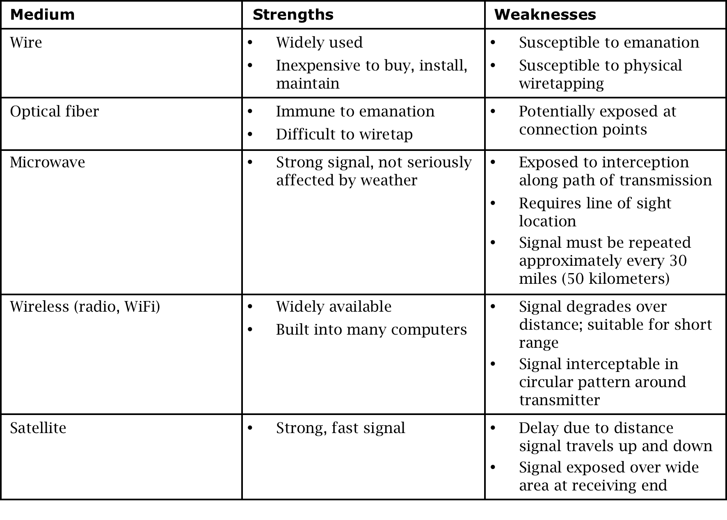
Communication Media Pros/Cons

Slide 6
The OSI Model
Notes:
While the OSI model doesn’t map perfectly to the network protocol stack that was adopted in practice, it’s so conceptually useful that it’s stood the test of time. In this chapter, we discuss vulnerabilities of, attacks against, and countermeasures for most of these layers. Students must understand what each layer is and that useful attacks can occur at any layer, so all require protecting.

Slide 7
Threats to Network Communications
Interception, or unauthorized viewing
Modification, or unauthorized change
Fabrication, or unauthorized creation
Interruption, or preventing authorized access
Notes:
The previous slides presented some basic background on networking. This slide begins a long section on threats to networks. Each of these bullets will get a group of detailed slides.

Slide 8
Security Perimeters
Notes:
This is the first slide on interception. The meaning of the graphic: Each of these places is a security perimeter in and of itself. Within each perimeter, you largely have control of your cables, devices, and computers because of physical controls, so you don’t need to worry as much about protection. But to do anything useful, you have to make connections between security perimeters, which exposes you to all sort of cables, devices, and computers you can’t control. Encryption is the most common and useful control for addressing this threat.

Slide 9
What Makes a Network Vulnerable to Interception?
Anonymity
An attacker can attempt many attacks, anonymously, from thousands of miles away
Many points of attack
Large networks mean many points of potential entry
Sharing
Networked systems open up potential access to more users than do single computers
System complexity
One system is very complex and hard to protect; networks of many different systems, with disparate OSs, vulnerabilities, and purposes are that much more complex
Unknown perimeter
Networks, especially large ones, change all the time, so it can be hard to tell which systems belong and are behaving, and impossible to tell which systems bridge networks
Unknown path
There may be many paths, including untrustworthy ones, from one host to another
Notes:
“Unknown perimeter” and “unknown path” are illustrated on the following two slides.

Slide 10
Unknown Perimeter
Notes:
This illustration

Slide 11
Unknown Path

Slide 12
Modification and Fabrication
Data corruption
May be intentional or unintentional, malicious or nonmalicious, directed or random
Sequencing
Permuting the order of data, such as packets arriving in sequence
Substitution
Replacement of one piece of a data stream with another
Insertion
A form of substitution in which data values are inserted into a stream
Replay
Legitimate data are intercepted and reused
Notes:
This slide ends the section on interception and moves on to modification and fabrication. Data corruption sources are illustrated on the next slide, and a replay example on the following. It’s helpful here to have students attempt to come up with examples of how each of these can result in a bad outcome.

Slide 13
Sources of Data Corruption

Slide 14
Simple Replay Attack

Slide 15
Interruption: Loss of Service
Routing
Internet routing protocols are complicated, and one misconfiguration can poison the data of many routers
Excessive demand
Network capacity is finite and can be exhausted; an attacker can generate enough demand to overwhelm a critical part of a network
Component failure
Component failures tend to be sporadic and unpredictable, and will cause loss of service if not planned for
Notes:
“Interruption” is the last of our four network threat types from earlier. This is the only slide that defines it. It will come up again with a whole section on denial-of-service attacks later in the chapter.

Slide 16
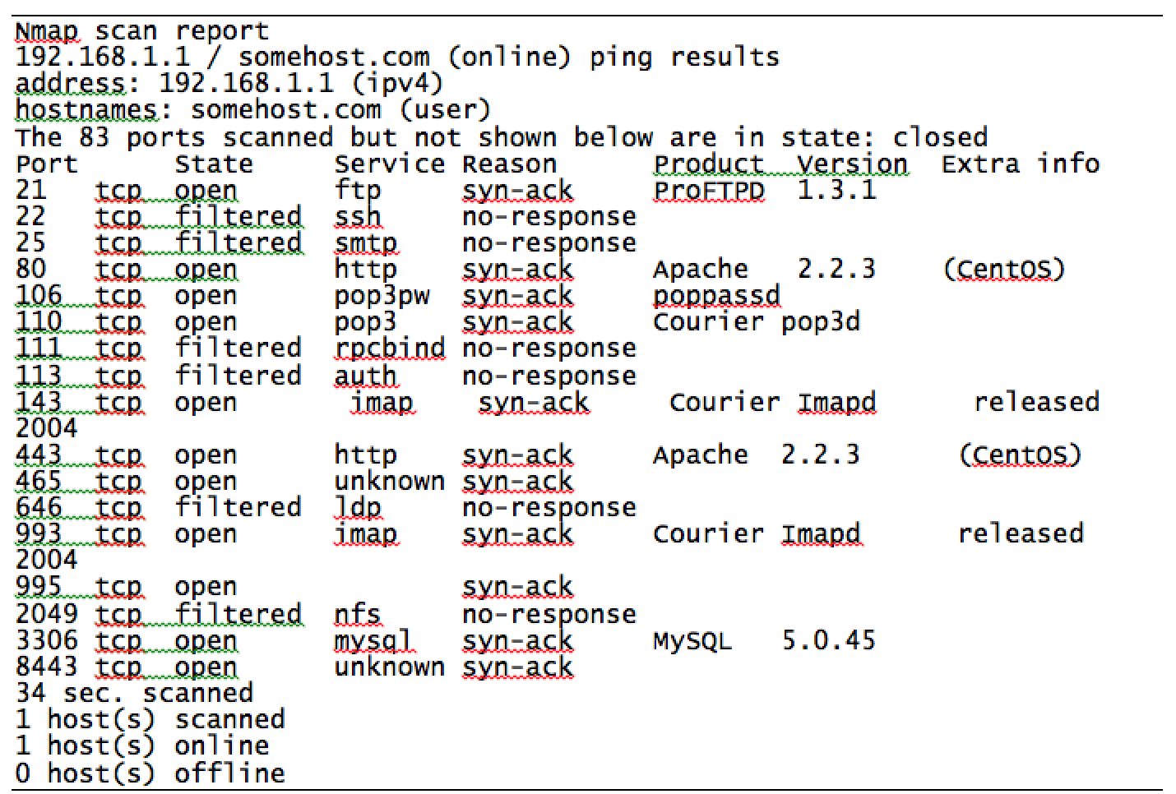
Port Scanning
Notes:
Port scanning can best be described as a reconnaissance—and as such doesn’t fit cleanly into the category of attack, threat, or vulnerability. We discuss it here to ensure that students understand it before we delve into attacks in more detail, as it is a common first step to attacks. The image is sample output from an NMAP port scan. Students should note the kind of data that’s available: port, protocol, state, service, product, and version.

Slide 17
Vulnerabilities in Wireless Networks
Confidentiality
Integrity
Availability
Unauthorized WiFi access
WiFi protocol weaknesses
Picking up the beacon
SSID in all frames
Association issues
Notes:
In this section we focus on WiFi, including WEP and WPA. The vulnerabilities on this page assume WiFi without encryption. We discuss encryption options on the following slides. Here is some explanation of how the above vulnerabilities apply to WiFi:
Confidentiality—Because every message in WiFi is a broadcast, unencrypted messages can be read by anyone who’s listening and within range
Integrity—When WiFi access points receive two streams of communication claiming to be the same computer, they necessarily accept the one with greater signal strength. This allows attackers to take over and forge sessions by spoofing legitimate computers and boosting signal strength.
Availability—In addition to the obvious availability issues, WiFi creates new availability problems, such as session hijacking, forced disassociation, and jamming.
Unauthorized WiFi access—Some form of cryptographic control is necessary to address this
Picking up the beacon—Hidden SSIDs can easily be discovered by monitoring client requests for SSIDs in the absence of SSID beacons from the access point
SSID in all frames—Similar to picking up the beacon, once a client connects to an access point, the SSID is stored in all communication frames and can be sniffed that way
Association issues—WiFi clients generally have preferred associations—networks they know and trust to connect to automatically—and these may include very common SSID names, such as AT&Twifi and Apple. Without additional security measures, attackers can spoof these trusted SSIDs and trick devices into connecting to rogue access points.

Slide 18
Failed Countermeasure: WEP
Wired equivalent privacy, or WEP, was designed at the same time as the original 802.11 WiFi standards as the mechanism for securing those communications
Weaknesses in WEP were first identified in 2001, four years after release
More weaknesses were discovered over the course of years, until any WEP-encrypted communication could be cracked in a matter of minutes

Slide 19
How WEP Works
Client and access point (AP) have a pre-shared key
AP sends a random number to the client, which the client then encrypts using the key and returns to the AP
The AP decrypts the number using the key and checks that it’s the same number to authenticate the client
Once the client is authenticated, the AP and client communicate using messages encrypted with the key

Slide 20
WEP Weaknesses
Weak encryption key
WEP allows to be either 64- or 128-bit, but 24 of those bits are reserved for initialization vectors (IV), thus reducing effective key size to 40 or 140 bits
Keys were either alphanumeric or hex phrases that users typed in and were therefore vulnerable to dictionary attacks
Static key
Since the key was just a value the user typed in at the client and AP, and since users rarely changed those keys, one key would be used for many months of communications
Weak encryption process
A 40-bit key can be brute forced easily. Flaws that were eventually discovered in the RC4 encryption algorithm WEP uses made the 104-bit keys easy to crack as well
Notes:
We do not go into a detailed explanation of IVs here, but it’s enough for students to know that they’re meant to be unpredictable seed data to kick off the encrypted communication in a strong way.

Slide 21
WEP Weaknesses (cont.)
Weak encryption algorithm
WEP used RC4 in a strange way (always a bad sign), which resulted in a flaw that allowed attackers to decrypt large portions of any WEP communication
IV collisions
There were only 16 million possible values of IV, which, in practice, is not that many to cycle through for cracking. Also, they were not as randomly selected as they should have been, with some values being much more common than others
Faulty integrity check
WEP messages included a checksum to identify transmission errors but did not use one that could address malicious modification
No authentication
Any client that knows the AP’s SSID and MAC address is assumed to be legitimate
Notes:
More interesting detail on the “weak encryption algorithm” bullet in the book.

Slide 22
WPA (WiFi Protected Access)
WPA was designed in 2003 as a replacement for WEP and was quickly followed in 2004 by WPA2, the algorithm that remains the standard today
Non-static encryption key
WPA uses a hierarchy of keys: New keys are generated for confidentiality and integrity of each session, and the encryption key is automatically changed on each packet
This way, the keys that are most important are used in very few places and indirect ways, protecting them from disclosure
Authentication
WPA allows authentication by password, token, or certificate

Slide 23
WPA (cont.)
Strong encryption
WPA adds support for AES, a much more reliably strong encryption algorithm
Integrity protection
WPA includes a 64-bit cryptographic integrity check
Session initiation
WPA sessions begin with authentication and a four-way handshake that results in separate keys for encryption and integrity on both ends
While there are some attacks against WPA, they are either of very limited effectiveness or require weak passwords
Notes:
Like so many other countermeasures in this book, WPA2 is adequately secure if configured well: Choose a strong encryption algorithm (AES without TKIP), and use a long, random passphrase.

Slide 24
Denial of Service (DoS)
DoS attacks are attempts to defeat a system’s availability
Volumetric attacks
Application-based attacks
Disabled communications
Hardware or software failure
Notes:
Specific examples of DoS attacks on the following slides.

Slide 25
DoS Attack: Ping Flood

Slide 26
DoS Attack: Smurf Attack

Slide 27
DoS Attack: Echo-Chargen

Slide 28
DoS Attack: Teardrop Attack
Notes:
The attacker sends packets that cannot possibly be reassembled (conflicting reassembly instructions). In extreme cases, this can cause the entire OS to lock up.

Slide 29
DoS Attack: DNS Spoofing
Notes:
The attacker acts as the DNS server in order to redirect the user to malicious sites.

Slide 30
DoS Attack: Rerouting Routing
Notes:
This picture doesn’t show anything malicious happening. It just shows how one router, C, advertises the routes it knows about to the routers adjacent to it. Routers rely on these advertising messages to be accurate; when they aren’t, DoS can ensue.

Slide 31
DoS Attack: Session Hijacking
Notes:
In this image of TCP session hijacking, an attacker is able to synchronize with a receiver while breaking synchronization with the sender and resetting the sender’s connection. The attacker continues the TCP session while the sender thinks the connection just broke off.

Slide 32
Distributed Denial of Service (DDoS)
Notes:
Conscript an army of compromised machines to attack a victim.
Choose a victim, and have the whole army unleash a DoS attack at once.
DDoS attacks are much more effective than traditional DoS attacks, employing a multiplied version of the same methods.

Slide 33
Botnets
Notes:
Botnets are networks of machines running malicious code under remote control. They often go undetected because they do little harm to the machines they run on. Botnets are often used to execute DDoS attacks. The image above shows how Botnet command and control (C&C) updates occur. The attacker is separated from the bots by multiple layers, making the attacker difficult to trace. Multiple redundant systems are built in so that if one master or C&C node is taken down, the bots can continue to connect to the botnet.

Slide 34
Link Encryption
Notes:
This slide begins a section on encryption for networks. We start with basic discussion of link encryption and end-to-end encryption, and then go into various tools that are commonly used for implementing network encryption.
In link encryption, data are encrypted just before the system places them on the physical communications link and are decrypted just as they arrive at the destination system. In this graphic, we see that the data is encrypted only at layer 1 of the previously discussed OSI stack. If the data is communicated through an intermediate node, that intermediate node will decrypt the data when it arrives, and then may re-encrypt it for the next link. Link encryption is appropriate when the transmission line is the point of greatest vulnerability, such as in wireless scenarios.

Slide 35
End-to-End Encryption
Notes:
In contrast with the previous slide, this end-to-end encryption diagram shows our data encrypted all the way up to OSI layer 7, the application layer. In real-world end-to-end encryption, such as those that use SSL, the data often isn’t encrypted all the way to layer 7; the important element is that intermediate nodes cannot decrypt the data. End-to-end encryption is appropriate whenever sending sensitive data through untrustworthy intermediate nodes, such as over the Internet.

Slide 36
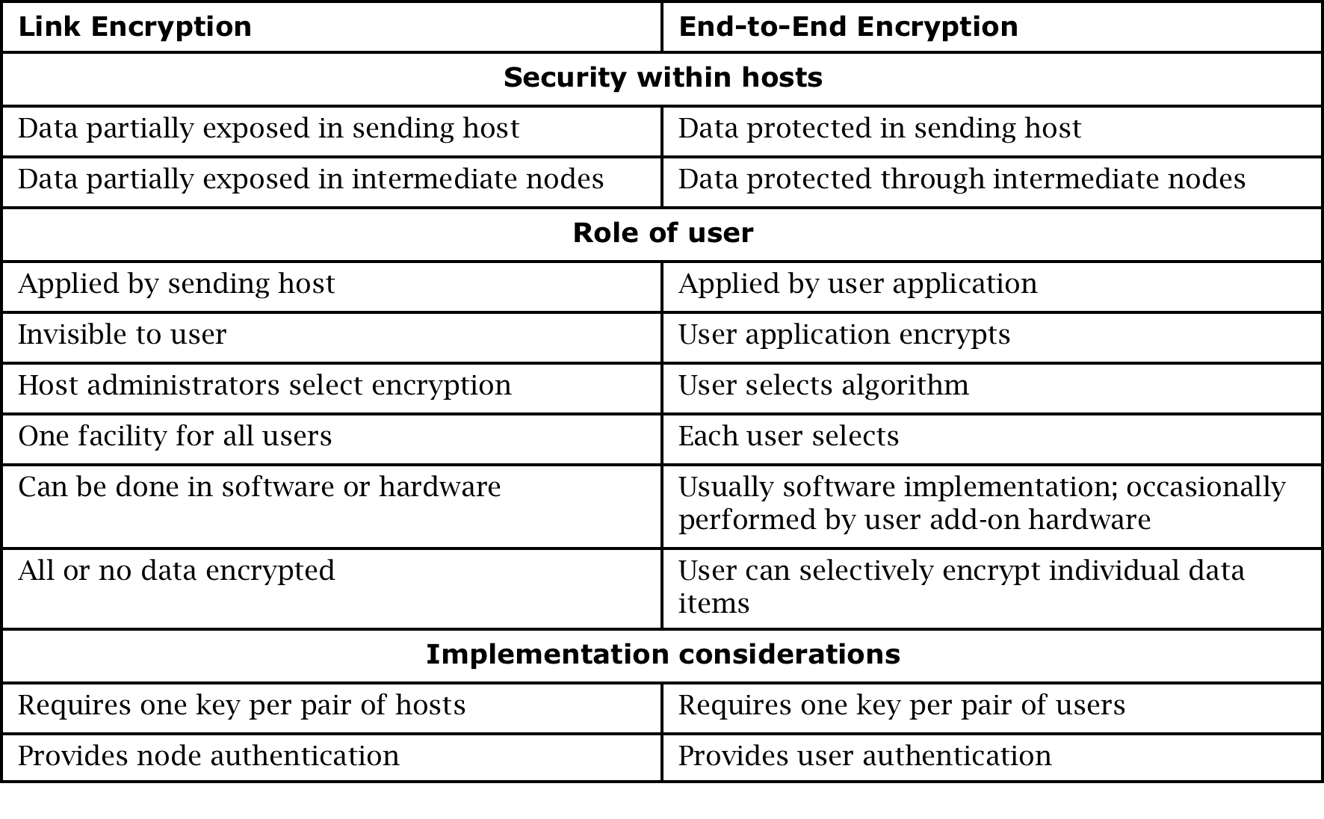
Link vs. End-to-End

Slide 37
Secure Shell (SSH)
Originally developed for UNIX but now available on most OSs
Provides an authenticated, encrypted path to the OS command line over the network
Replacement for insecure utilities such as Telnet, rlogin, and rsh
Protects against spoofing attacks and modification of data in communication

Slide 38
SSL and TLS
Secure Sockets Layer (SSL) was designed in the 1990s to protect communication between a web browser and server
In a 1999 upgrade to SSL, it was renamed Transport Layer Security (TLS)
While the protocol is still commonly called SSL, TLS is the modern, and much more secure, protocol
SSL is implemented at OSI layer 4 (transport) and provides
Server authentication
Client authentication (optional)
Encrypted communication

Slide 39
SSL Cipher Suites
At the start of an SSL session, the client and server negotiate encryption algorithms, known as the “cipher suite”
The server sends a list of cipher suite options, and the client chooses an option from that list
The cipher suite consists of
A digital signature algorithm for authentication
An encryption algorithm for confidentiality
A hash algorithm for integrity
Notes:
Cipher suite negotiation is at the center of a very common SSL configuration vulnerability. It is very common for servers to be configured to offer as many cipher suites as possible to provide broad compatibility. But if a server offers cipher suite options that have significant known vulnerabilities (many do), it presents the opportunity for a man-in-the-middle to negotiate on the client’s behalf for a weak cipher suite that the attacker can break.

Slide 40
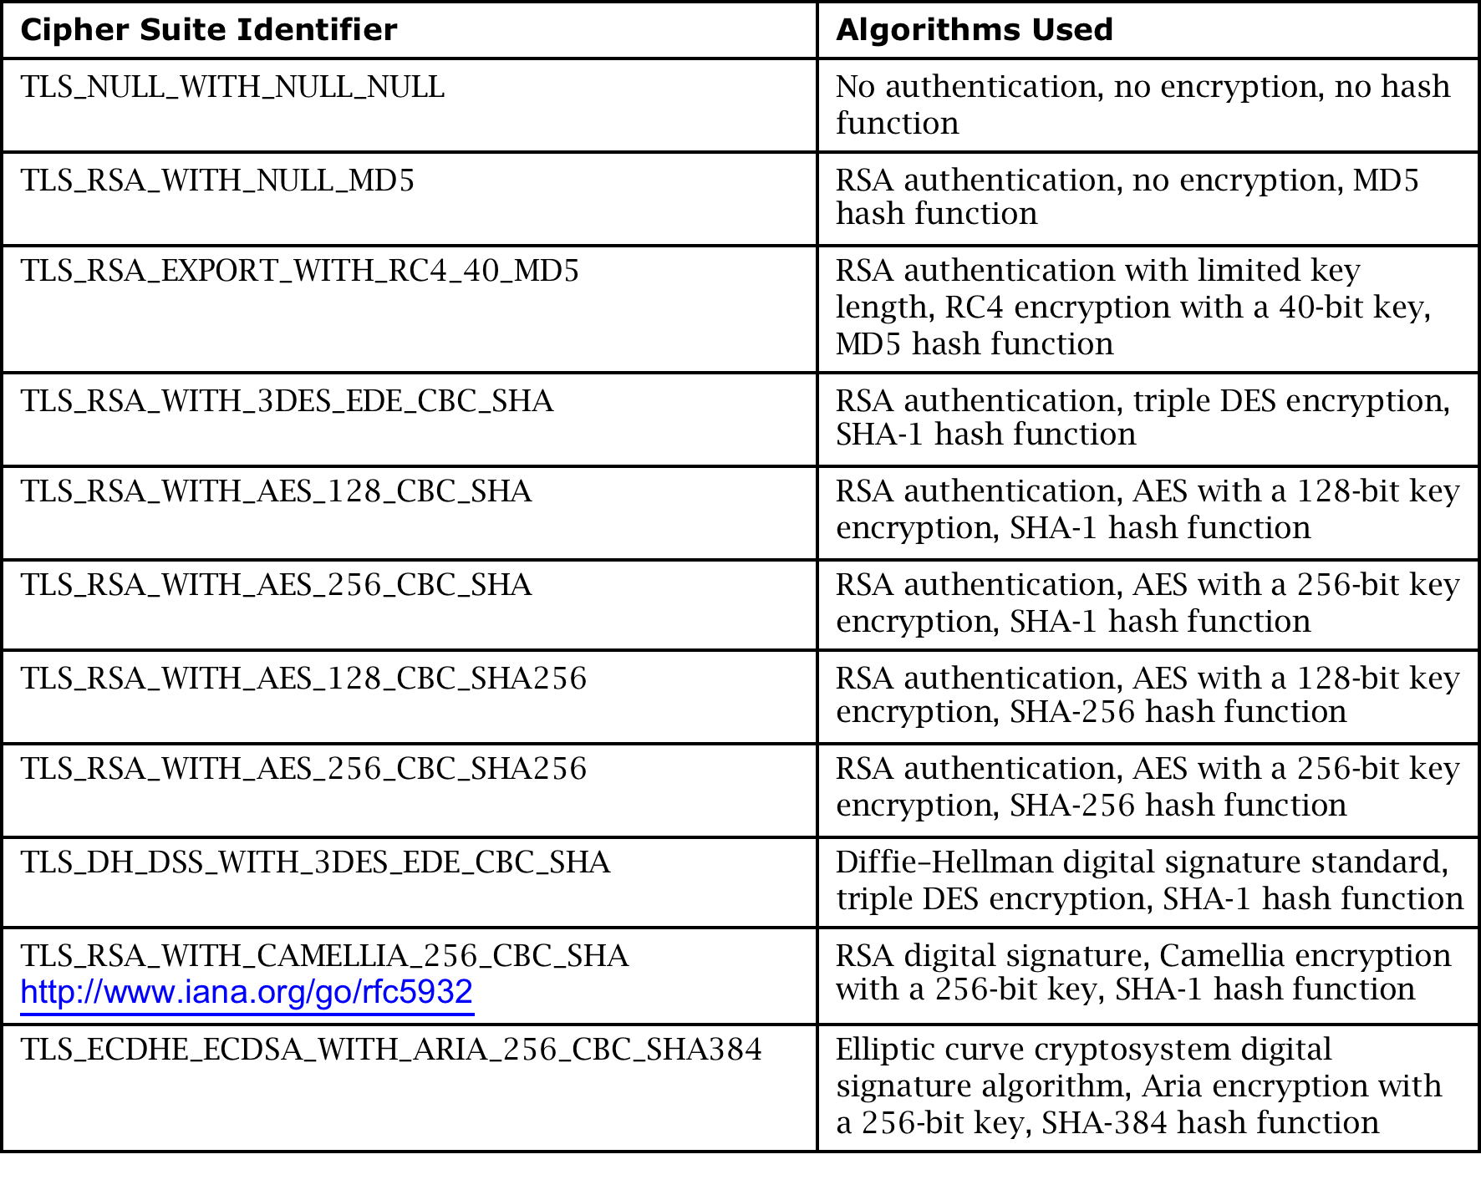
SSL Cipher Suites (Partial List)

Slide 41
SSL Session Established
Notes:
In this dialog, we see that the site is verified, who the certificate authority is, and the choice of encryption algorithm.

Slide 42
SSL Certificate
Notes:
In this dialog, we see the certificate details: the domain name being certified, the company that owns the site, the CA that issued the certificate, and the relevant dates.

Slide 43
Chain of Certificates
Notes:
The top window shows the chain of certificates, starting with GTE CyberTrust Global Root and ending with this site. This dialog also shows the algorithm used for signing the certificate.
It’s important for students to understand that the security of most of the Internet relies on these chains of trust. If GTE CyberTrust is trusted by my browser, and it, or one of the CAs it authorizes, signs a certificate, then that certificate is valid as far as my browser is concerned. Over the past few years, sophisticated attackers have successfully attacked major CAs to exploit this exact vulnerability in the system.

Slide 44
Onion Routing
Onion routing prevents an eavesdropper from learning source, destination, or content of data in transit in a network
This is particularly helpful for evading authorities, such as when users in oppressive countries want to communicate freely with the outside world
Uses asymmetric cryptography, as well as layers of intermediate hosts, so that
The intermediate host that sends the message to the ultimate destination cannot determine the original sender, and
The host that received the message from the original sender cannot determine the ultimate destination

Slide 45
Virtual Private Networks (VPN)
Notes:
In this picture, a VPN—an encrypted tunnel that provides confidentiality and integrity for communication between two sites over public networks—connects Office A to Office B over the Internet so they appear to their users as one seamless, private network. The VPN is terminated by firewalls at both ends, which is often the case in the real world.

Slide 46
VPN (cont.)
Notes:
In this VPN scenario, a teleworker uses a VPN to connect to a remote office. She authenticates to the firewall (that’s acting as a VPN server), and the firewall passes that authentication information to the servers in the office so she can be appropriately access controlled.

Slide 47
Firewalls
A device that filters all traffic between a protected or “inside” network and less trustworthy or “outside” network
Most firewalls run as dedicated devices
Easier to design correctly and inspect for bugs
Easier to optimize for performance
Firewalls implement security policies, or set of rules that determine what traffic can or cannot pass through
A firewall is an example of a reference monitor, which means it should have three characteristics:
Always invoked (cannot be circumvented)
Tamperproof
Small and simple enough for rigorous analysis
Notes:
The reference monitor concept was previous discussed in chapters 2 and 5.

Slide 48
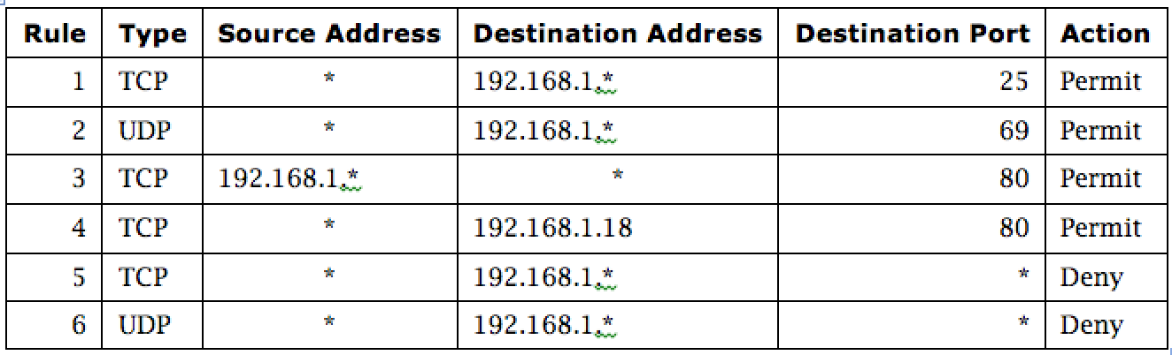
Firewall Security Policy
Notes:
In this example firewall configuration,
External traffic can reach the entire internal network on TCP/25 and UDP/69.
Internal traffic can go out to port 80 on the external network.
External traffic can reach TCP/80 on one internal server.
All other traffic from external to internal is disallowed.

Slide 49
Types of Firewalls
Packet filtering gateways or screening routers
Stateful inspection firewalls
Application-level gateways, also known as proxies
Circuit-level gateways
Guards
Personal or host-based firewalls

Slide 50
Packet-Filtering Gateways
Notes:
A packet-filtering gateway controls access on the basis of packet address and specific transport protocol type (e.g., HTTP traffic). The example firewall configuration table on a previous slide was in relation to a packet-filtering gateway. In the image on this slide, the firewall is filtering out Telnet traffic but allowing HTTP traffic in. There is a second packet-filtering gateway image on the next slide.

Slide 51
Packet-Filtering Gateways (cont.)
Notes:
In this image, the firewall is filtering traffic on the basis of source IP rather than port. Filtering rules can also be based on combinations of addresses and ports/protocols.

Slide 52
Stateful Inspection Firewall
Notes:
Packet-filtering gateways maintain no state from one packet to the next. They simply look at each packet’s IP addresses and ports and compare them to the configured policies. Stateful inspection firewalls, on the other hand, maintain state information from one packet to the next. In the example in the image, the firewall is counting the number of systems coming from external IP 10.1.3.1; after the external system reaches out to a fourth computer, the firewall hits a configured threshold and begins filtering packets from that address. In real life, it can be difficult to define rules that require state/context and that attackers cannot circumvent.

Slide 53
Application Proxy
Notes:
An application proxy simulates the behavior of an application at OSI layer 7 so that the real application receives only requests to act properly. Application proxies can serve a number of purposes:
Filtering potentially dangerous application-layer requests
Log requests/accesses
Cache results to save bandwidth
Perhaps the most common form of application proxies in the real world is a web proxy, which companies often use to monitor and filter employee Internet use.

Slide 54
Circuit-Level Gateway
Notes:
A circuit-level gateway is a firewall that essentially allows one network to be an extension of another. It operates at OSI layer 5, the session layer, and it functions as a virtual gateway between two networks. One use of a circuit-level gateway is to implement a VPN.

Slide 55
Guard
A sophisticated firewall that, like an application proxy, can interpret data at the protocol level and respond
The distinction between a guard and an application proxy can be fuzzy; the more protection features an application proxy implements, the more it becomes like a guard
Guards may implement any programmable set of rules; for example:
Limit the number of email messages a user can receive
Limit users’ web bandwidth
Filter documents containing the word “Secret”
Pass downloaded files through a virus scanner

Slide 56
Personal Firewalls
Notes:
A personal firewall runs on a workstation or server and can enforce security policy like other firewalls. In addition to restricting traffic by source IP and destination port, personal firewalls can restrict which applications are allowed to use the network. In this example Windows firewall configuration dialog, an administrator can select which protocols and applications should be allowed to communicate to and from the host.

Slide 57
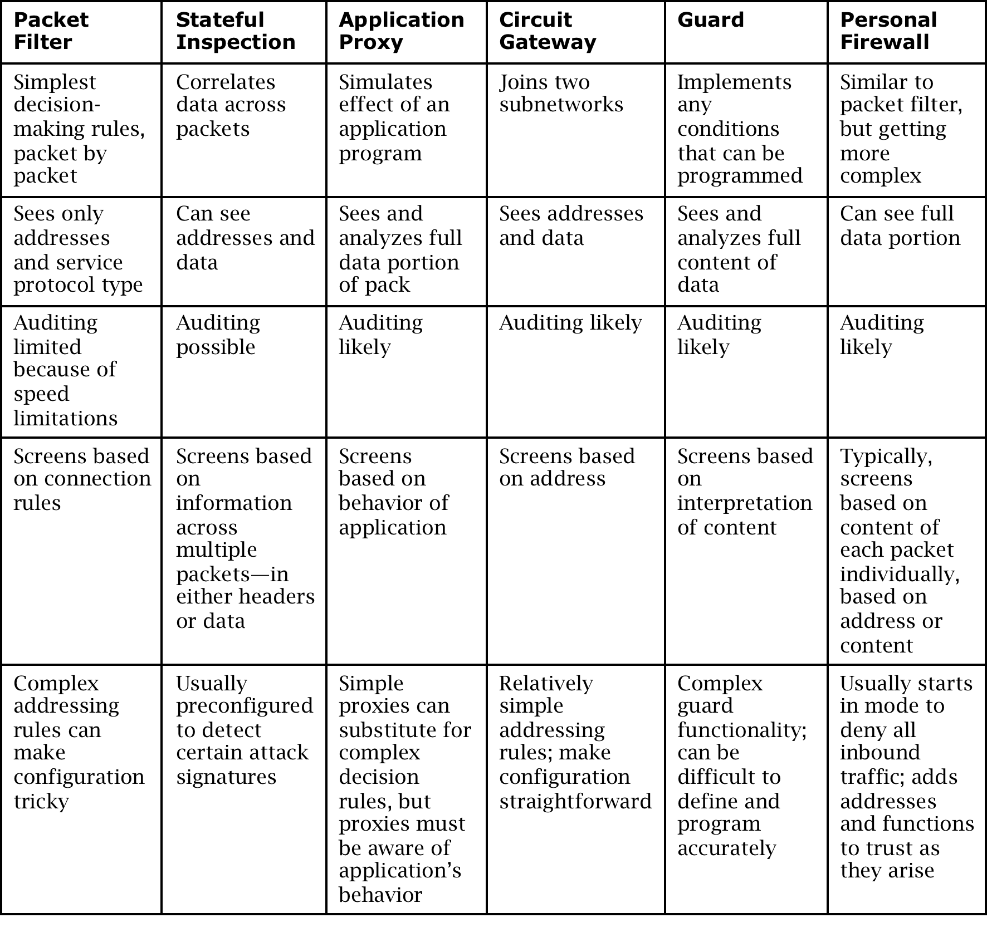
Comparison of Firewall Types

Slide 58
Demilitarized Zone (DMZ)
Notes:
A DMZ is a form of network architecture in which a network enclave is dedicated to services that should be somewhat accessible from the outside. In this example, a firewall protects a DMZ that contains web, email, and FTP servers, and a second firewall protects an internal network—that should not be reachable from the Internet—from the DMZ in case a DMZ host becomes compromised. The benefit of such a configuration is that the hosts that need to be accessible from the Internet—and are therefore most at risk from outside attack—can only do limited damage to the internal hosts that do not need to be reachable from the Internet. An even more careful option would separate the web, email, and FTP servers from one another with further firewalls.

Slide 59
What Firewalls Can and Cannot Do
Firewalls can protect an environment only if they control the entire perimeter
Firewalls do not protect data outside the perimeter
Firewalls are the most visible part of an installation to the outside, so they are an attractive target for attack
Firewalls must be correctly configured, that configuration must be updated as the environment changes, and firewall activity reports must be reviewed periodically for evidence of attempted or successful intrusion
Firewalls exercise only minor control over the content admitted to the inside, meaning that inaccurate or malicious code must be controlled by means inside the perimeter

Slide 60
Network Address Translation (NAT)
Notes:
With NAT, the source firewall converts the source address in the packet into the firewall’s own address. The firewall also makes an entry in a translation table showing the destination address, the source port, and the original source address to be able to forward any replies to the original source address. The firewall then converts the address back on any return packets. This has the effect of concealing the true address of the internal host and prevents the internal host from being reached directly.

Slide 61
Data Loss Prevention (DLP)
DLP is a set of technologies that can detect and possibly prevent attempts to send sensitive data where it is not allowed to go
Can be implemented as
Agent installed as an OS rootkit
Guard
Indicators DLP looks for:
Keywords
Traffic patterns
Encoding/encryption
DLP is best for preventing accidental incidents, as malicious users will often find ways to circumvent it

Slide 62
Intrusion Detection Systems (IDS)
Notes:
IDSs complement preventative controls as a next line of defense. IDSs monitor activity to identify malicious or suspicious events. IDSs may
Monitor user and system activity
Audit system configurations for vulnerabilities and misconfigurations
Assess integrity of critical system and data files
Recognize known attack patterns in system activity
Identify abnormal activity through statistical analysis
Manage audit trails and highlight policy violations
Install and operate traps to record information about intruders

Slide 63
Types of IDS
Detection method
Signature-based
Heuristic
Location
Front end
Internal
Scope
Host-based IDS (HIDS)
Network-based IDS (NIDS)
Capability
Passive
Active, also known as intrusion prevention systems (IPS)
Notes:
Signature-based IDS can only detect known patterns. Heuristic IDS looks for patterns of behavior that are out of the ordinary. A front-end IDS looks at traffic as it enters the network, while an internal IDS monitors traffic within the network. A host-based IDS protects a single host by monitoring traffic from the OS, while a network-based IDS is a server or appliance that monitors network traffic. An IPS is an IDS that tries to block or otherwise prevent suspicious or malicious behavior once it is detected.

Slide 64
Security Information and Event Management (SIEM)
Notes:
SIEMs are software systems that collect security-relevant data—usually audit logs—from a variety of hardware and software products to create a unified security dashboard for security operations center personnel. Without an SIEM, analysts would need to log into each device individually on a constant basis and would have to manually correlate events on one system against events on another, which is impossible on any reasonably sized system. SIEMs range in functionality from simple ones that allow for basic search and alerting to complex platforms that allow for completely custom dashboards, reports, alerts, and correlation.

Slide 65
Summary
Networks are threatened by attacks aimed at interception, modification, fabrication, and interruption
WPA2 has many critical security advantages over WEP
DoS attacks come in many flavors, but malicious ones are usually either volumetric in nature or exploit a bug
Network encryption can be achieved using specialized tools—some for link encryption and some for end-to-end—such as VPNs, SSH, and the SSL/TLS protocols
A wide variety of firewall types exist, ranging from very basic IP-based functionality to complex application-layer logic, and both on networks and hosts
There are many flavors of IDS, each of which detects different kinds of attacks in very different parts of the network

